Slide 1
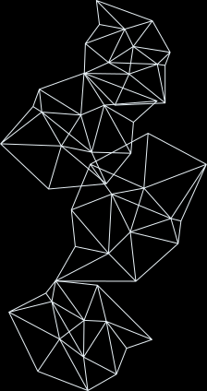


NUTRI LENS AI
Presented by
K PREM KUMAR[24BK1A66BM]
NIRANJAN SINGH[24BK1A66BX]
PRINCE PATEL[24BK1A66CH]
GUIDE
SEMINAR OVERALL COORDINATOR
HOD-CSE(AIML)
Mrs K Katyayani
Dr. P. Deepan

Slide 2

INTRODUCTION
    NUTRI LENS AI Helps people understand packaged food labels according to their health needs.
    It explains the ingredients, highlights possible risks and suggests healtheir food choices.

Slide 3
DOMAIN OF THE PROJECT
  Health tech / Digital Health tech
  Artificial Intelligence , Optical Character Recognition

Slide 4
PROBLEM STATEMENT
    Food labels are often difficult to understand.
    Users may not know how ingredients affect their health.
    People with conditions like diabetes, high BP, or allergies need personalized food guidance.
    A simple system is needed to explain labels and suggest healthier options.

Slide 5
OBJECTIVE OF THE STUDY
    To read and analyze food labels using AI and OCR
    To explain the food’s health effects based on the user’s health profile
    To suggest healthier alternatives for better food choices

Slide 6

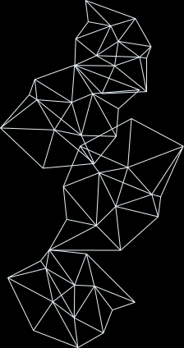

SYSTEM WORK FLOW
Does the food fit the user’s health profile?
Start
User registers with health details
User uploads a food label
OCR extracts ingredients and nutrition
AI analyzes the food according to the user’s health profile
YES
NO
Show personalized health effects
Suggest healthier food choices
End

Slide 7
METHODOLOGY
1. Vision & Preprocessing: Auto-deskews, denoises, and enhances curved or reflective food label images.
2. Multi-Mode OCR & Confidence Scoring: Extracts dense packaging text using Tesseract with real-time confidence scores (0–100%).
3. NLP & Chemical Alias Mapping: Cleans boilerplate text and maps E-numbers, chemical derivatives, and scientific names to canonical ingredients.
4. Personalized Safety & Reverse Product Engine : Checks against user allergies, diets, and health goals (Safe / Caution / Avoid).
Identifies the exact packaged product and recommends healthier finished shelf alternatives.

Slide 8
TECH STACK
BACKEND
      Python
      Flask 3.0 (web framework)
      FRONTEND
      HTML 5 , CSS 3
      DATABASE
      MySQl
      IMAGE PROCESSING & OCR
      Tesseract OCR

Slide 9
REFERENCES
  FDA & FSSAI — Big-9 allergen laws & packaging display regulations.
  Codex Alimentarius — International E-number & additive standards.
  FARE & WHO — Clinical allergy risk models & nutritional intake benchmarks.
  Tesseract & Open Food Facts — Core OCR vision engine & packaged product database.

Slide 10
CONCLUSION
    NUTRI LENS AI helps users understand packaged food labels in a simple way.
    It provides personalized health information based on the user’s profile and suggests healthier food choices

Slide 11
THANK YOU

